Slide 1
ASEAN
Digital marketing in Vietnam

Slide 2

Group members:
1. Sreynich penh
3. Saroeuen sareth
5. Toun sophan
2. Pho mengheang
4. Sen siny

Slide 3
What is digital marketing?
Digital marketing in Vietnam
C
O N T
E
N
T
Digital marketing Opportunities in Vietnam
Summary Digital marketing in Vietnam

Slide 4

1. What is digital marketing?

Slide 5
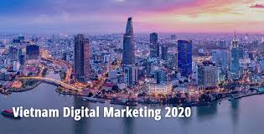
2. Digital Marketing in Vietnam

Slide 6
3. Digital marketing opportunities in Vietnam
Video marketing in Vietnam.
Social media marketing in Vietnam.
KOL Influencer marketing in Vietnam.

Slide 7
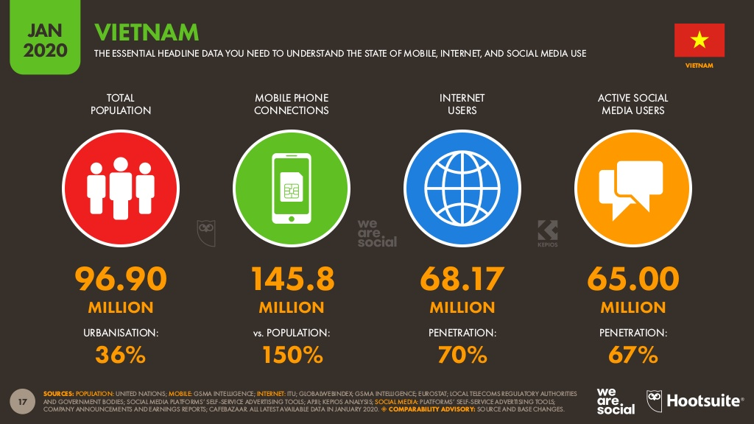
4.Summary of Digital Marketing in Vietnam

Slide 8

Any Question?

Slide 9





Thank you !
www.passerellesnumeriques.org

